Slide 1




vSoC: Efficient Virtual System-on-Chip on Heterogeneous Hardware
Jiaxing Qiu¹, Zijie Zhou¹, Yang Li¹, Zhenhua Li¹, Feng Qian², Hao Lin^{1,3},
Di Gao¹, Haitao Su¹, Xin Miao¹, Yunhao Liu¹, Tianyin Xu³
1
2
3
Notes:
Thanks for the introduction. Good morning everyone. I am Jiaxing Qiu from Tsinghua University. Today I am giving a talk of our paper titled vSoC, efficient virtual system-on-chip on heterogeneous hardware.

Slide 2


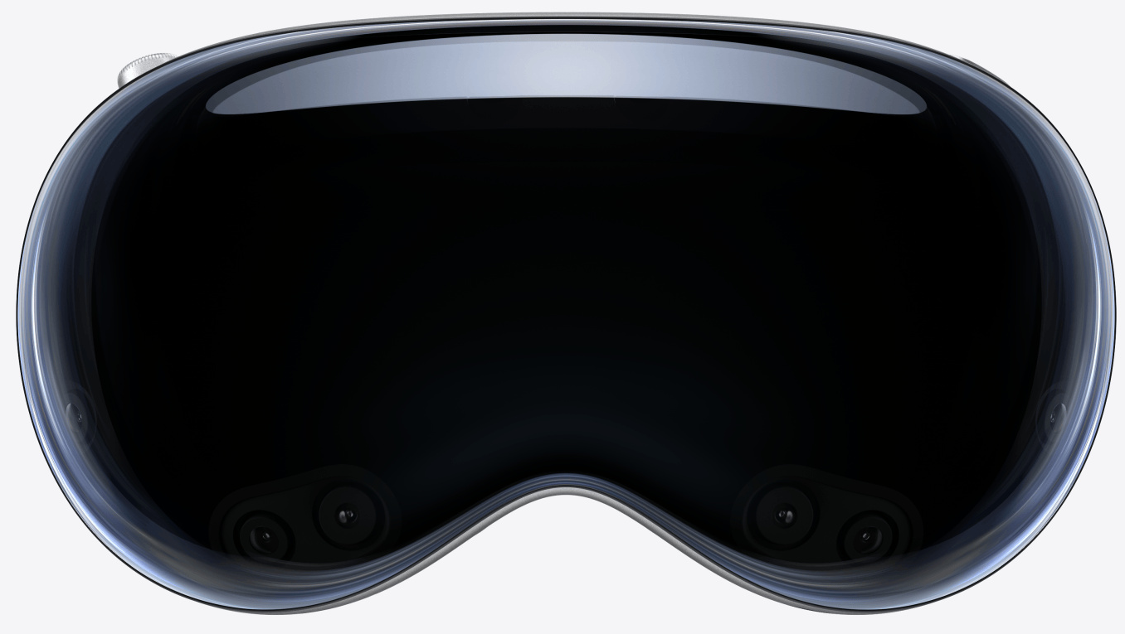




Emerging Mobile Platforms Host High-Throughput Apps
New mobile platforms lead to a burst of emerging apps
Emerging apps on those platforms have high performance requirements
  e.g., UHD, 60 FPS, sub-100 ms latency
Notes:
With the appearance of new mobile platforms like AR headsets, smart TVs and smart cars, emerging apps like AR, VR and UHD video are being increasingly deployed. To ensure satisfying user experience on those new mobile platforms, emerging apps need high performance, like UHD resolution, high framerates, and low end-to-end latency.

Slide 3
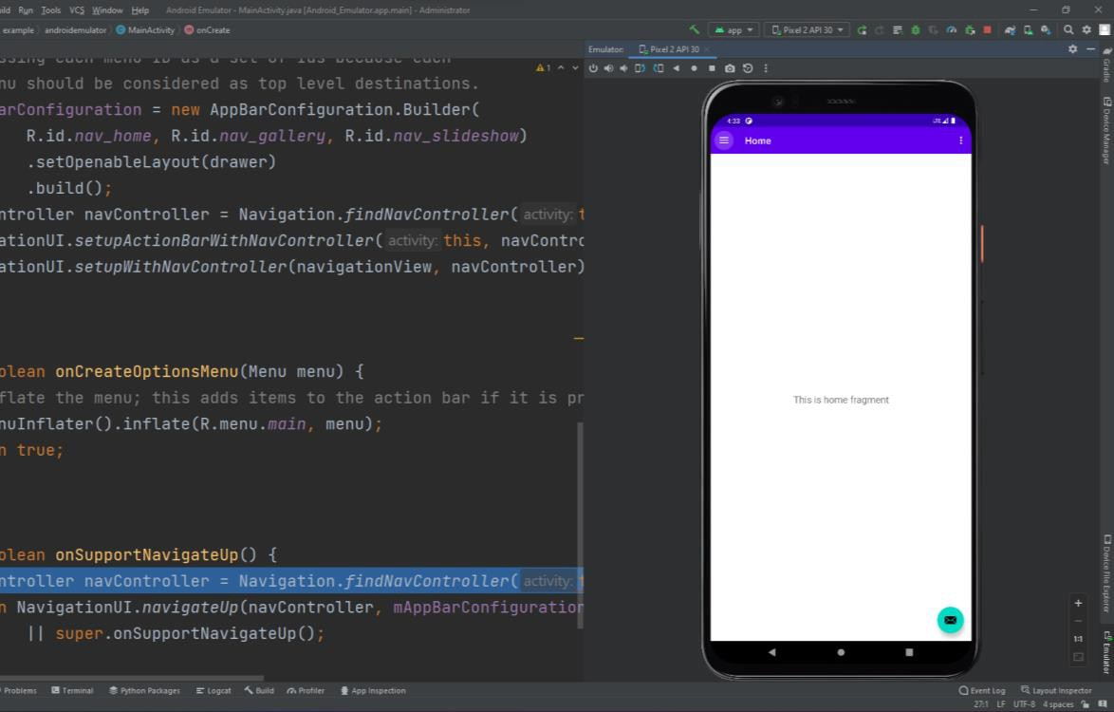
Emerging Apps Need Mobile Emulators
Used for emerging app development, debugging, testing, cloud deployment
Unique advantages and features
  cost-effective
  highly customizable
  root access
    Instrumentation
    memory introspection
  snapshot
  …
Notes:
When developing, testing and deploying emerging apps, mobile emulators play an important role, due to their unique advantages. Firstly, cost efficiency. With mobile emulators you don’t need to purchase physical devices anymore, especially considering that those new mobile platforms are quite expensive. You don’t want to buy a smart car before staring to developing an app on it, right. Besides, mobile emulators enables cool features like memory inspection and snapshots.

Slide 4
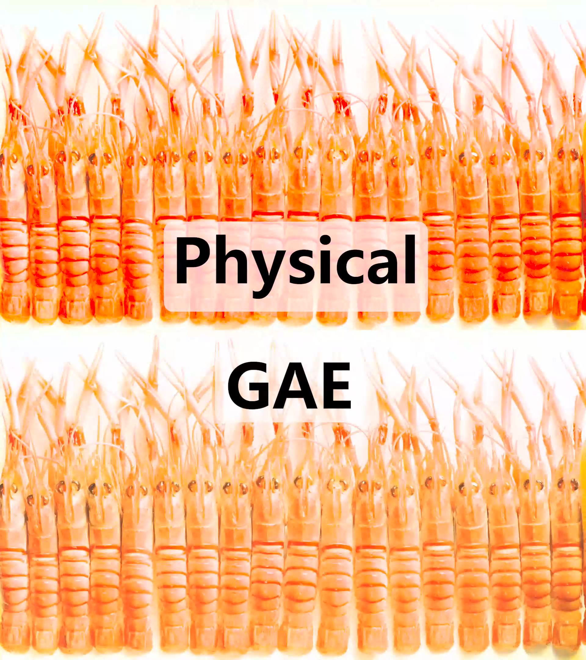
Emerging Apps Perform Badly on Mobile Emulators
E.g., AR apps
E.g., UHD video apps
Device | FPS | Latency (ms)
Physical device | 58 | 86
Google Android Emulator | 29 | 364
QEMU-KVM | 22 | 273
LDPlayer | 24 | 246
Bluestacks | 3 | 182
Notes:
Nevertheless, emerging apps perform badly on mobile emulators. As shown in the table, even the state-of-the-art mobile emulators can only achieve half framerate and twice end-to-end latency compared to physical devices. An intuitive video is provided on the right: Google Android Emulator, abbreviated as GAE, is much less smooth than physical device when playing UHD videos, seriously impacting developer experience.

Slide 5

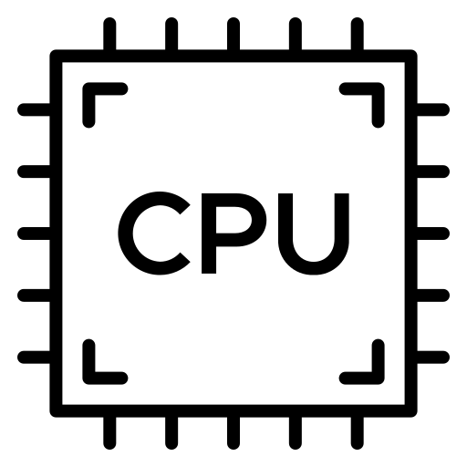

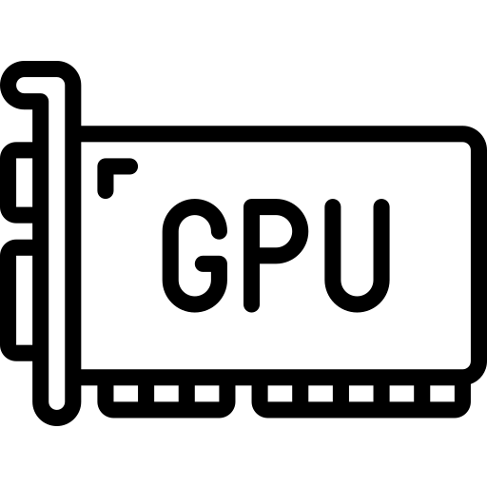

Emerging Apps Perform Badly on Mobile Emulators
E.g., AR apps
I/O virtualization is an active area of research
  e.g. QEMU (ATC’05), THINC (SOSP’05), Trinity (OSDI’22)
Device | FPS | Latency (ms)
Physical device | 58 | 86
Google Android Emulator | 29 | 364
QEMU-KVM | 22 | 273
LDPlayer | 24 | 246
Bluestacks | 3 | 182
What’s wrong?
Disp
NIC
Notes:
On the other hand, I/O virtualization has been a hot area of research. Many related work has greatly improved the virtualization efficiency of various mobile hardware including CPU, display, GPU. What’s wrong then with the mobile emulators?
Therefore, our paper sets out to clear up the mystery.

Slide 6





Our Contributions
Revealing the cause of undesirable emulator performance
  memory architecture discrepancy between mobile and PC/server hardware
In-depth understanding of mobile shared memory and its role in virtualization
Design and implementation of an efficient virtual SoC on heterogeneous PC/server hardware
1.8× - 9.0× performance improvements on emerging mobile apps
Adoption by HUAWEI DevEco Studio
Artifact available at: https://github.com/virtualsoc/vsoc
Notes:
We first reveal the cause of undesirable emulator performance …
Let’s begin with the memory architecture discrepancy.

Slide 7
Memory Architecture of Mobile Devices
Unified: mobile devices are built into one system-on-chip (SoC)
Devices physically share memory
Shared memory
CPU
GPU
interconnect
Cam
ISP
…
Notes:
Mobile hardware typically uses a unified design for better power efficiency: …各种硬件设备都被打包到一个芯片里，并且通过高通量总线共享一块物理内存。Let’s see a Qualcomm SoC example…

Slide 8
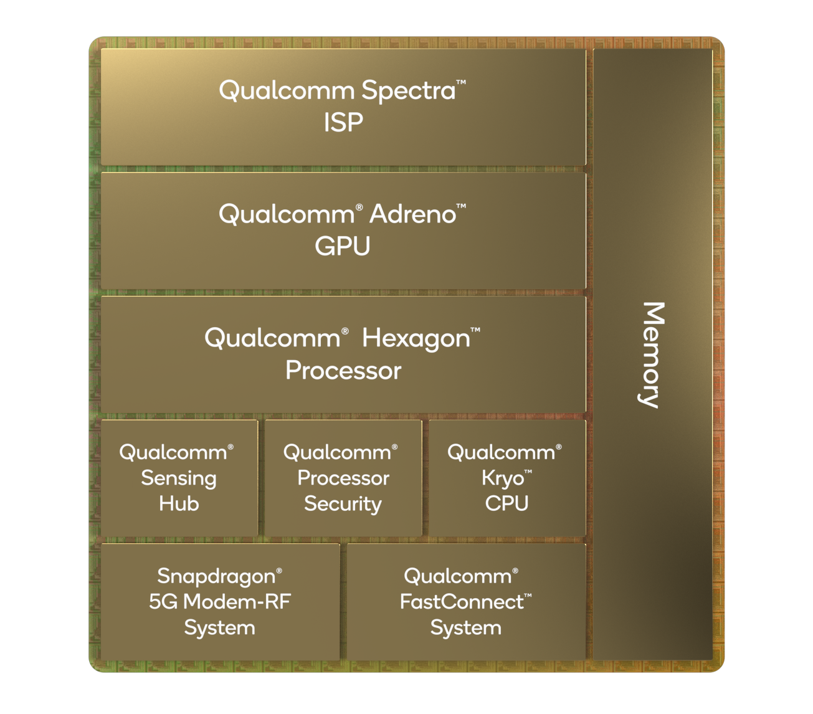
Memory Architecture of Mobile Devices
Unified: mobile devices are built into one system-on-chip (SoC)
Devices physically share memory
Shared memory
CPU
GPU
interconnect
Cam
ISP
…
e.g., Qualcomm Snapdragon 8gen2 SoC
Notes:
Mobile hardware typically uses a unified design for better power efficiency: …各种硬件设备都被打包到一个芯片里，并且通过高通量总线共享一块物理内存。Let’s see a Qualcomm SoC example. You can see that the numerous mobile devices on the left physically share a piece of memory highlighted in red.

Slide 9
Mobile/Desktop Memory Architecture Discrepancy
Mobile: unified
Mobile devices share memory
PC/server: modular
PC/server devices have dedicated memory
Shared memory
CPU memory
DDR
CPU
CPU
GPU
PCIe
PCIe
USB
interconnect
GPU
Codec
Cam
mem
mem
ISP
…
Cam
Mobile emulators need to provide an illusion of shared memory
Notes:
On the other hand, desktop hardware are modular and loosely coupled. 毕竟对于PC/服务器硬件，如果坏了一块得能够及时更换才行。因此，桌面硬件通过（例如PCIe或者USB）总线和CPU相连。并且，由于很多高通量的设备（比如说GPU），它们距离CPU内存较远，所以通常会各自配备独立内存。
于是，对于移动模拟器来说，一个非常核心的问题就是，如何基于异构的独立内存，来为移动系统提供一种共享虚拟内存的假象。

Slide 10
Shared Virtual Memory (SVM) in Mobile Emulators
Local copies of data stored in PC/server devices
Coherence maintenance: data copies need to be synchronized
CPU memory
copy 1
DDR
Mobile Apps
SVM
PCIe
CPU
PCIe
System Services
One logical region
USB
GPU
Codec
copy 2
copy 3
Cam
Multiple physical copies
Notes:
To this end, mobile emulators typically adopt a shared virtual memory architecture. Essentially, the emulator keeps local copies of data in PC/server devices. Those copies logically belong to one shared virtual memory region and mobile apps and system services interact with the logical SVM region. The essential challenge of SVM lies in the coherence of the copies: the emulator needs to synchronize data between the copies to make sure that the mobile system always accesses the newest data.

Slide 11
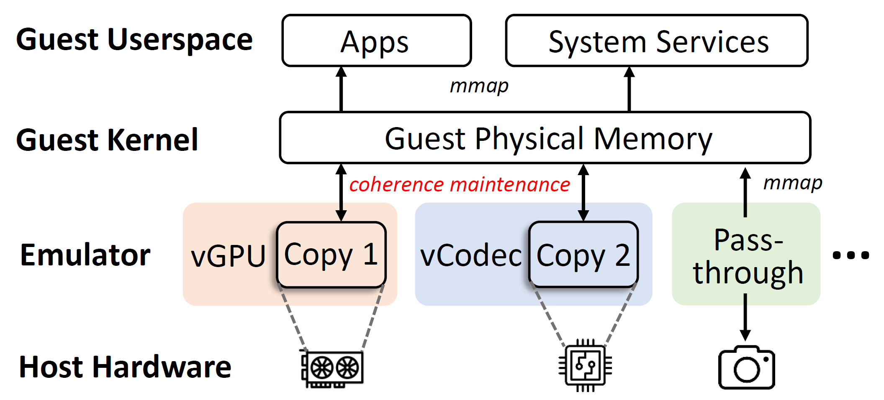
Performance Bottleneck of Typical Emulators
Typical emulators follow the modular device architecture
  Virtual devices are isolated and agnostic from each other
Notes:
And unfortunately, such coherence maintenances are a key performance bottleneck of typical emulators. 主流的移动模拟器仍然遵循着桌面硬件的模块化思路，虚拟设备之间例如图中的vGPU和vCodec编解码器设备之间彼此独立。但是，移动系统中需要数据共享，于是现有的移动模拟器普遍只能借助客户操作系统来完成数据共享。

Slide 12
Performance Bottleneck of Typical Emulators
Coherence maintenance relies on guest memory
Notes:
More concretely, 对于每块共享虚拟内存，客户机内核都会分配一块内存，并映射到用户态，使得移动系统服务和应用都能访问到同一块共享的客户机内存。(click) The emulator needs to synchronize the device-local copies with the allocated guest memory …

Slide 13
Performance Bottleneck of Typical Emulators
Coherence maintenance relies on guest memory
Notes:
More concretely, 对于每块共享虚拟内存，客户机内核都会分配一块内存，并映射到用户态，使得移动系统服务和应用都能访问到同一块共享的客户机内存。(click) The emulator needs to synchronize the device-local copies with the allocated guest memory and ensure the guest memory always contain the newest data.

Slide 14
Performance Bottleneck of Typical Emulators
Repeated copying reduces throughput and introduces latency
  e.g., codec writes to shared memory, and GPU reads afterwards
②
①
Notes:
Unfortunately, that architecture brings significant performance problems。假如 vGPU 需要读取 vCodec 设备中写入的数据，则需要先把数据从 vCodec 设备中拷贝到客户机，再从客户机拷贝回 GPU。多次拷贝浪费带宽、且带来高时延。

Slide 15
Measurement of Mobile Shared Memory Usage
5 types of emerging apps (UHD + 60 FPS + ≥3 devices)
1 physical device (Google Pixel 6a) + 2 emulators (GAE, QEMU-KVM)
Instrumentation of Android OS & emulators
Notes:
为了量化理解模拟器的低效架构以及共享内存的真实使用模式，we conducted a measurement with 50 emerging apps from 5 categories。测量涉及一个真机和两个开源的主流模拟器，测量方法是对它们进行细粒度插桩。

Slide 16
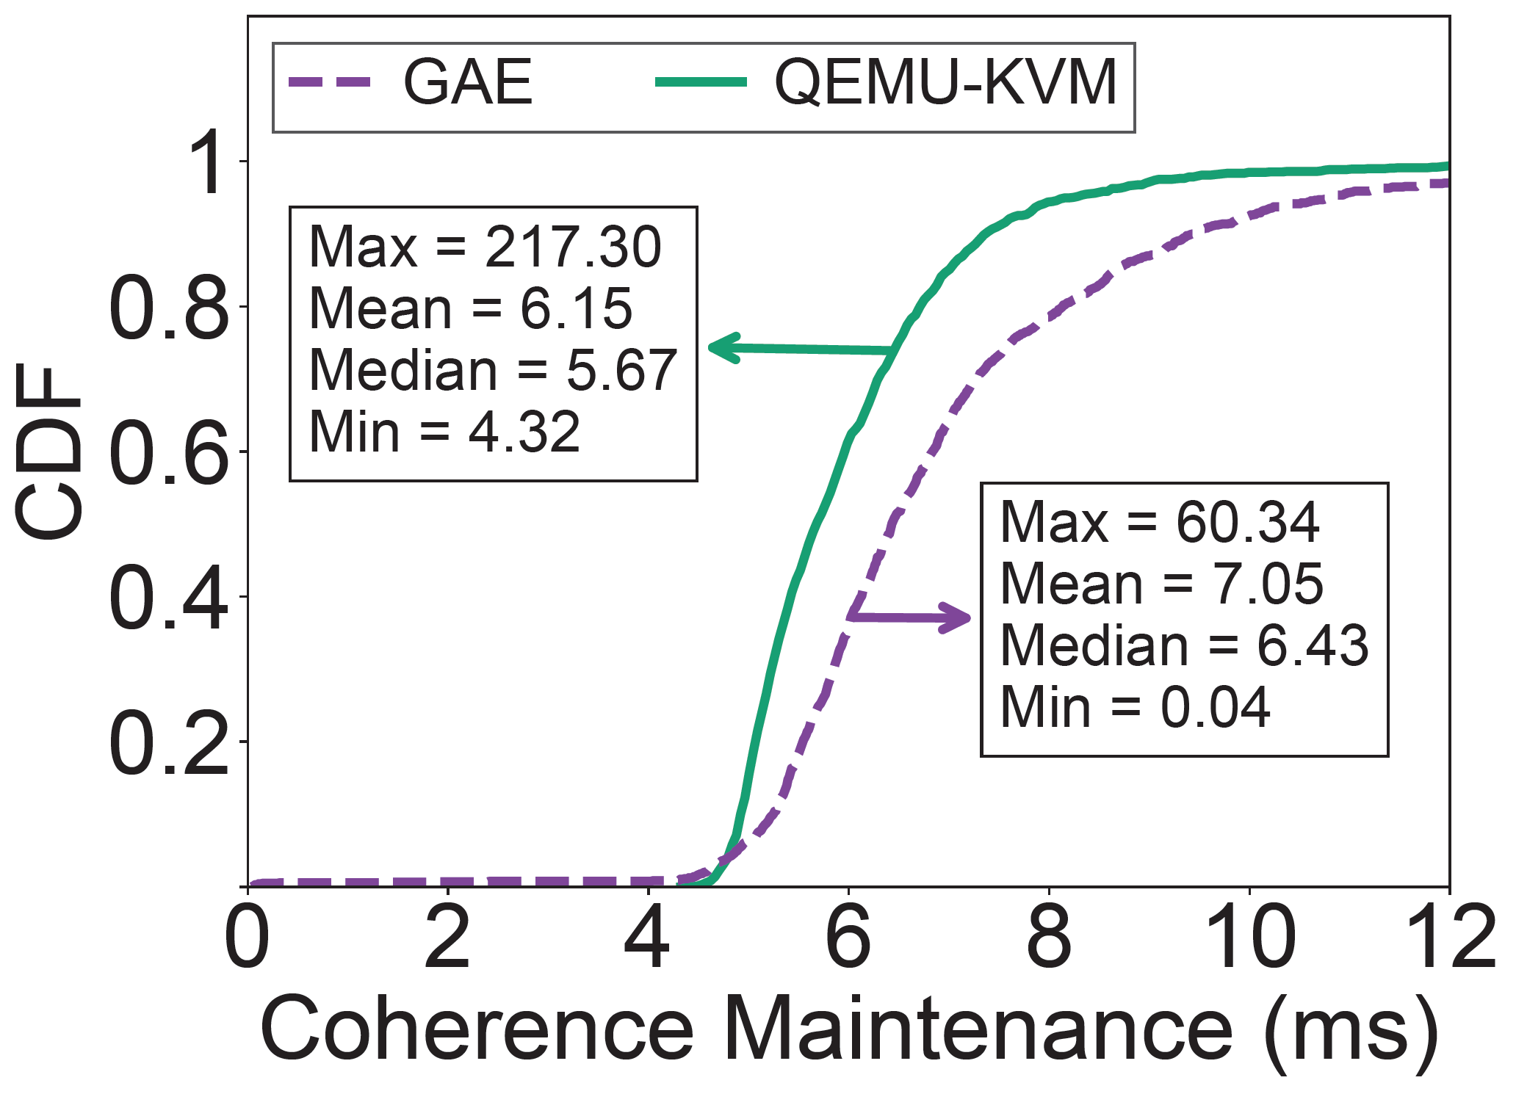
Key Measurement Findings
Emulator coherence maintenance is slow
  mobile shared memory has high throughput (avg. 5.8 MiB/op × 292 ops/sec ≈ 1 GiB/s)
  -> average coherence time: 6.6 ms/op
reference: if an app runs at 60 FPS, each frame only has 16 ms time budget
Notes:
The measurement findings firstly proved our previous analysis: 共享内存吞吐量很大，模拟器共享内存一致性维护非常缓慢，平均 6.6 ms。As a reference, if an app runs at 60 frames per second, each frame only has a 16 ms time budget.

Slide 17


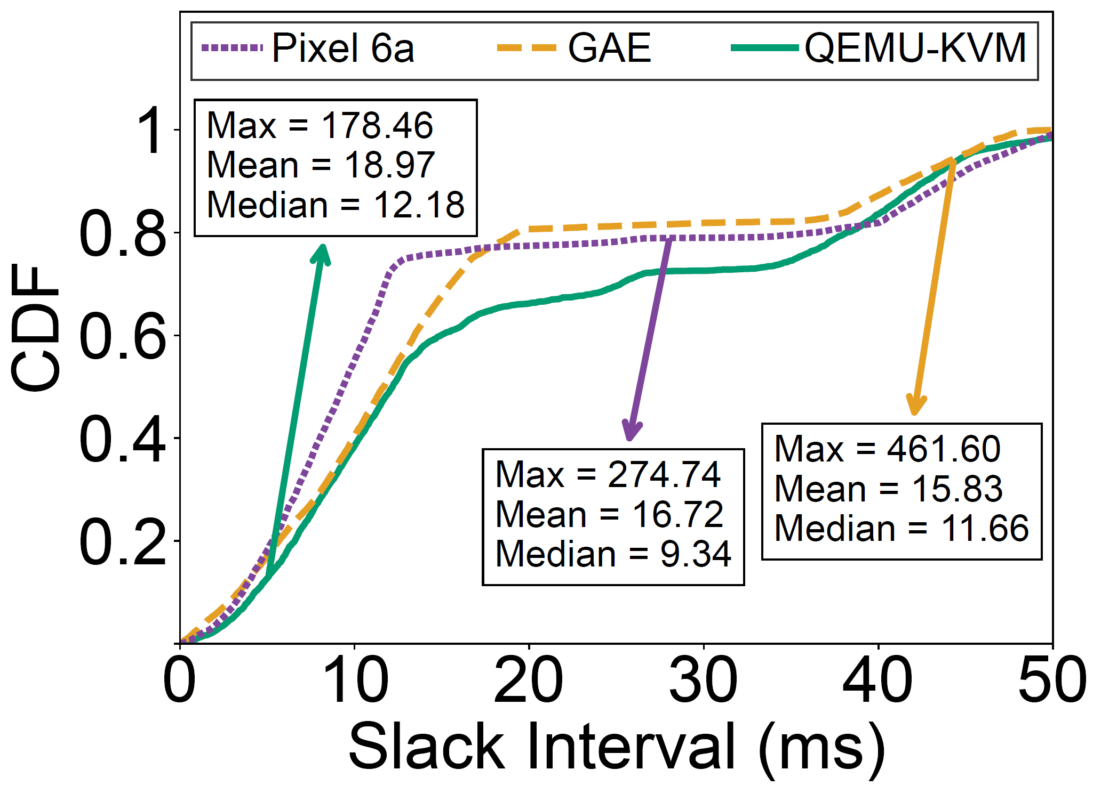
Key Measurement Findings
Emulator coherence maintenance is slow
  mobile shared memory has high throughput (avg. 5.8 MiB/op × 292 ops/sec ≈ 1 GiB/s)
  -> average coherence time: 6.6 ms/op
Mobile shared memory has slack intervals
  slack interval: idle time between consecutive shared memory accesses (avg. 17.2 ms)
  reason: OS synchronization mechanisms, e.g., buffering and VSync
Notes:
At the same time, we discover an important feature of mobile shared memory usage: slack intervals。所谓松弛间隔是指，两次连续的共享内存访问之间通常存在较长的空闲时间，平均17.2 ms。这是因为移动系统为了确保共享内存不被并发写入，也会加入缓冲、VSync等机制来对连续共享内存操作进行同步。

Slide 18
Key Measurement Findings
Emulator coherence maintenance is slow
  mobile shared memory has high throughput (avg. 5.8 MiB/op × 292 ops/sec ≈ 1 GiB/s)
  -> average coherence time: 6.6 ms/op
Mobile shared memory has slack intervals
  slack interval: idle time between consecutive shared memory accesses (avg. 17.2 ms)
  reason: OS synchronization mechanisms, e.g., buffering and VSync
Challenges
Key insight: hide coherence maintenance under the slack intervals
by prefetching data
Virtual devices are isolated
Memory usage predictions are hard
Cross-device memory accesses need synchronization
Notes:
The existence of slack intervals give us a key insight。既然松弛间隔的17.2 ms比一致性维护的6.6 ms长，我们就可以采取一种预取的策略，提前进行一致性维护，这样就可以将一致性维护的开销隐藏在松弛间隔之下。In reality, however, the prefetch idea faces various challenges that forces us to give up the modular virtual device architecture in seek of a new one.

Slide 19
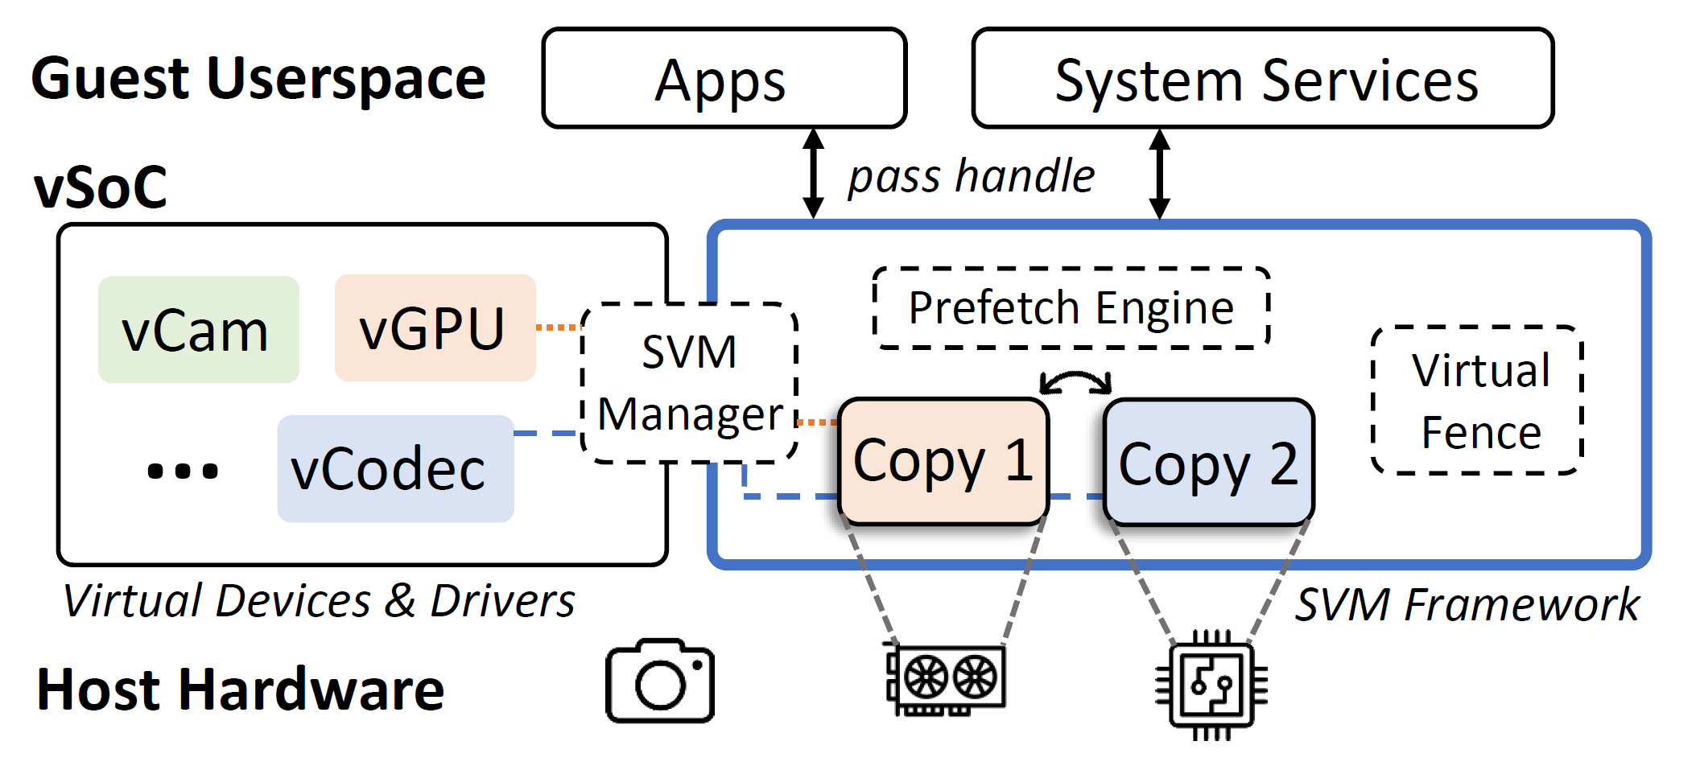
vSoC: Efficient Virtual SoC on Heterogeneous Hardware
Core idea: Virtual SoC ≠ sum(virtual devices)!
Paravirtualized SVM Framework
  enables efficient data sharing between virtual devices
  three modules: SVM manager, Prefetch Engine, Virtual Fence
Notes:
And the result is our system, vSoC. The core idea is that a virtual soc should not be a simple sum of virtualized devices. Instead, we break the boundaries between virtual devices and build a paravirtualized SVM framework which is highlighted in blue. The SVM framework consists of three modules and we will introduce them one by one.

Slide 20
vSoC > Shared Virtual Memory (SVM) Manager
Global management of SVM regions
Direct data path between virtual devices
Notes:
首先我们介绍共享内存管理器…

Slide 21
vSoC > SVM Manager
Direct data path between virtual devices
E.g., video rendering (codec write + GPU read)
Guest involved
②
③
Host mem
Guest
DDR
PCIe
CPU
PCIe
①
④
USB
GPU
Codec
Cam
Old architecture: 4 memory copies
Notes:
Take video rendering as an example, in which the codec writes and GPU reads from a SVM region. For the old modular architecture, four memory copies are involved each frame: two copies into the guest memory, and another two out of it. Transferring data from the codec device to guest memory needs two copies, (click) because existing APIs by Intel/NVIDIA need contiguous virtual memory as the destination of transfer…

Slide 22

vSoC > SVM Manager
Direct data path between virtual devices
E.g., video rendering (codec write + GPU read)
Guest involved
②
③
Host mem
Contiguous virtual memory is needed!
Guest
DDR
PCIe
CPU
PCIe
①
④
USB
GPU
Codec
Cam
Old architecture: 4 memory copies
Notes:
Take video rendering as an example, in which the codec writes and GPU reads from a SVM region. For the old modular architecture, four memory copies are involved each frame: two copies into the guest memory, and another two out of it. Transferring data from the codec device to guest memory needs two copies, (click) because existing APIs by Intel/NVIDIA need contiguous virtual memory as the destination of transfer. Nevertheless, guest memory is incontiguous from the perspective of an emulator, so data need to be first buffered to host memory before copying page-by-page to guest memory.

Slide 23
vSoC > SVM Manager
Direct data path between virtual devices
E.g., video rendering (codec write + GPU read)
Guest involved
②
No guest involvement
③
Host mem
Host mem
Guest
Guest
DDR
②
DDR
PCIe
CPU
PCIe
①
PCIe
CPU
PCIe
①
④
USB
USB
GPU
Codec
GPU
Codec
Cam
Cam
Old architecture: 4 memory copies
Our architecture: ≤2 memory copies
Notes:
In contrast, our architecture only takes two, because we know that the data will finally go to GPU and the guest CPU will not access it. Therefore, there is no need of copying data to and from the guest at all. (click) Moreover, in special cases when the GPU and codec are in fact one device…

Slide 24
vSoC > SVM Manager
Special case: In-GPU
Direct data path between virtual devices
E.g., video rendering (codec write + GPU read)
GPU/Codec
Guest involved
②
No guest involvement
①
③
Host mem
Host mem
Guest
Guest
DDR
②
DDR
PCIe
CPU
PCIe
①
PCIe
CPU
PCIe
①
④
USB
USB
GPU
Codec
GPU
Codec
Cam
Cam
Old architecture: 4 memory copies
Our architecture: ≤2 memory copies
Notes:
In contrast, our architecture only takes two, because we know that the data will finally go to GPU and the guest CPU will not access it. Therefore, there is no need of copying data to and from the guest at all. (click) Moreover, in special cases when the GPU and codec are in fact one device, data do not even have to leave the GPU, leading to very fast coherence maintenances.

Slide 25
vSoC > Prefetch Engine
Decides when to perform coherence maintenances
Provides a robust coherence protocol based on prefetch
Notes:
接下来介绍预取引擎。

Slide 26

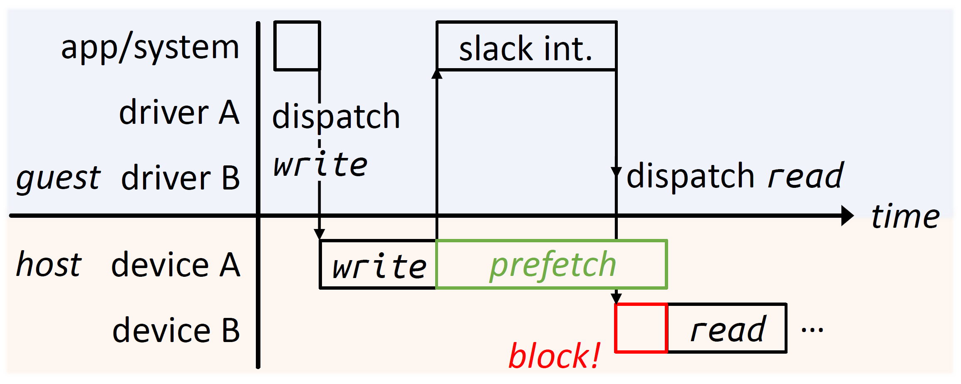
vSoC > Prefetch Engine > Is Prefetch Robust?
Challenge 1: prefetch may lead to app performance loss
  in 26% of the measurement cases, slack intervals cannot fully cover prefetch, leading to high access latency
  but the mobile system assumes zero access latency, leading to frame drops
Planned completion time
Timeout, drop frame
Notes:
While the prefetch idea sounds easy, implementing a robust prefetch protocol has several challenges。第一个挑战是，预取可能会导致应用性能损失。如下图所示，在不少情况下，松弛间隔不足以覆盖一致性维护，导致虚拟设备B访问共享内存的时候，预取还没有完成。此时设备B只能阻塞等待，导致最后读取操作超时，应用发生丢帧等现象。

Slide 27

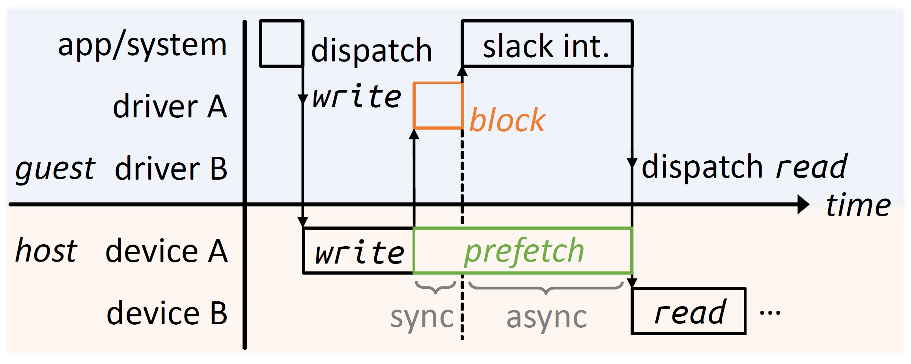
vSoC > Prefetch Engine > Semi-Async Prefetch
Challenge 1: prefetch may lead to app performance loss
Solution: semi-async prefetch
  driver A proactively blocks rather than let driver B block passively
Planned completion time
Notes:
为了解决这个问题，我们提出了半异步预取的协议。其关键就是让客户机驱动提前预测松弛间隔能否覆盖预取的时间开销。假如说不够，那么driver A proactively blocks to compensate for the time delta, so that device B will not be blocked when reading from the shared memory.

Slide 28
vSoC > Prefetch Engine > Hypergraphs
Challenge 2: prefetch involves multiple predictions that can be inaccurate
  e.g. next accessing device, slack intervals, coherence time
Notes:
Besides, prefetch has another challenge: it involves multiple predictions that can be inaccurate. (click) To solve the problem, we use twin hypergraphs to collect various cross-layer data to facilitate the predictions…

Slide 29
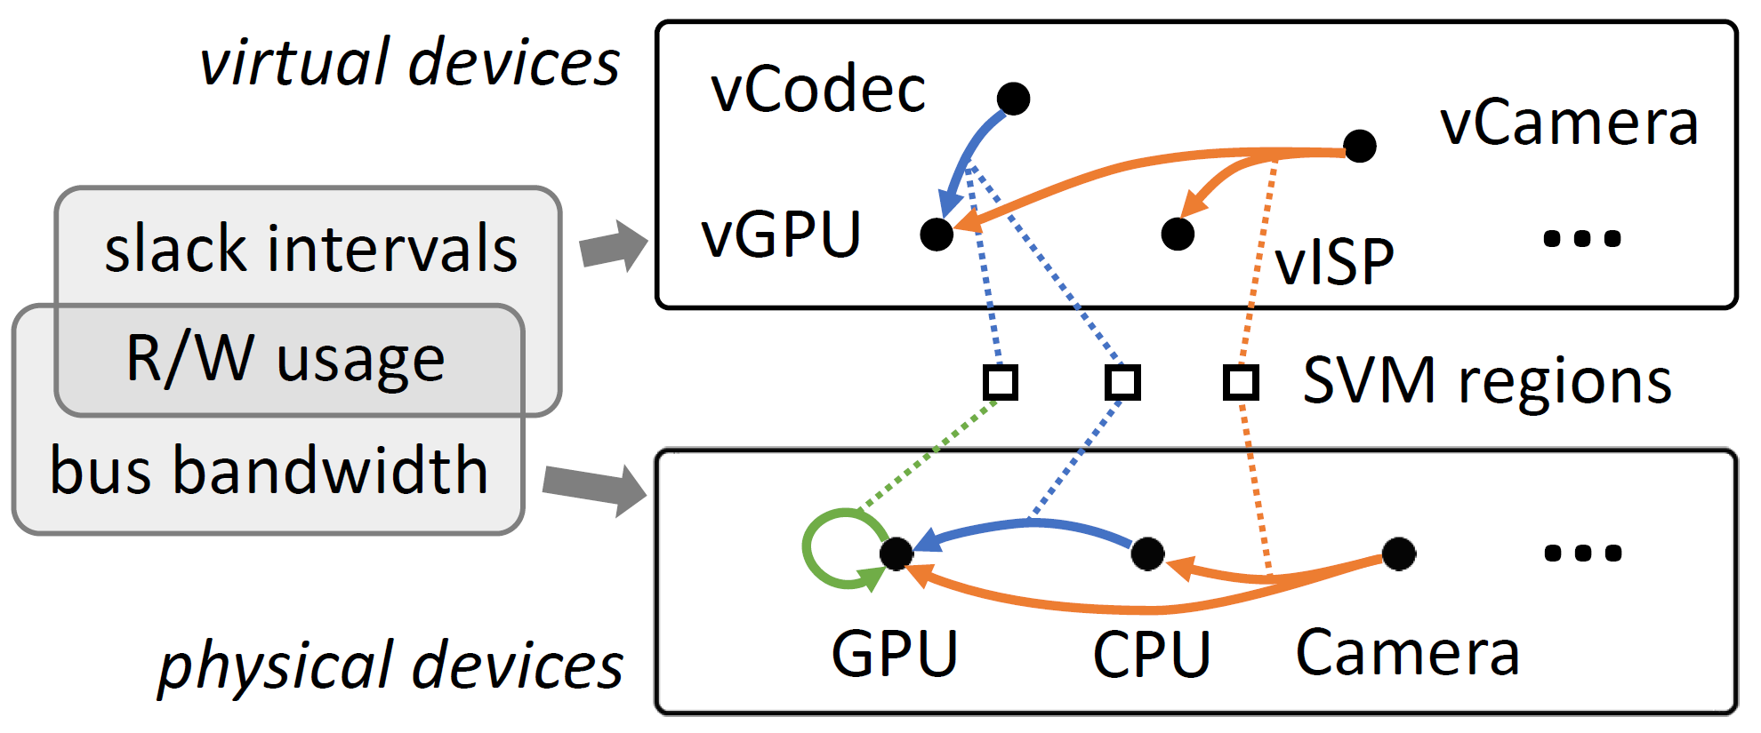
vSoC > Prefetch Engine > Hypergraphs
Challenge 2: prefetch involves multiple predictions that can be inaccurate
  e.g. next accessing device, slack intervals, coherence time
Solution: twin hypergraphs
  two hypergraphs respectively model the data flow of virtual/physical devices
  zero-shot predictions in terms of data flows instead of individual regions
Notes:
Besides, prefetch has another challenge: it involves multiple predictions that can be inaccurate. (click) To solve the problem, we use twin hypergraphs to collect various cross-layer data to facilitate the predictions. 如下方的图所示，两个超图分别model虚拟设备和物理设备的数据流。我们使用两个超图是因为虚拟设备和物理设备的拓扑不一定相同，比如说如果底层没有硬件编解码器，我们就只能软件解码视频，此时虚拟codec设备就应该对应到物理CPU上。We categorize individual SVM regions into data flows to facilitate predictions of newly allocated svm regions. Since new regions do not have usage history, so we use information from their associated data flow for more accurate predictions.

Slide 30
vSoC > Virtual Fence
Ensures cross-device commands are executed in the expected order
Notes:
然后我们介绍虚拟指令屏障。

Slide 31
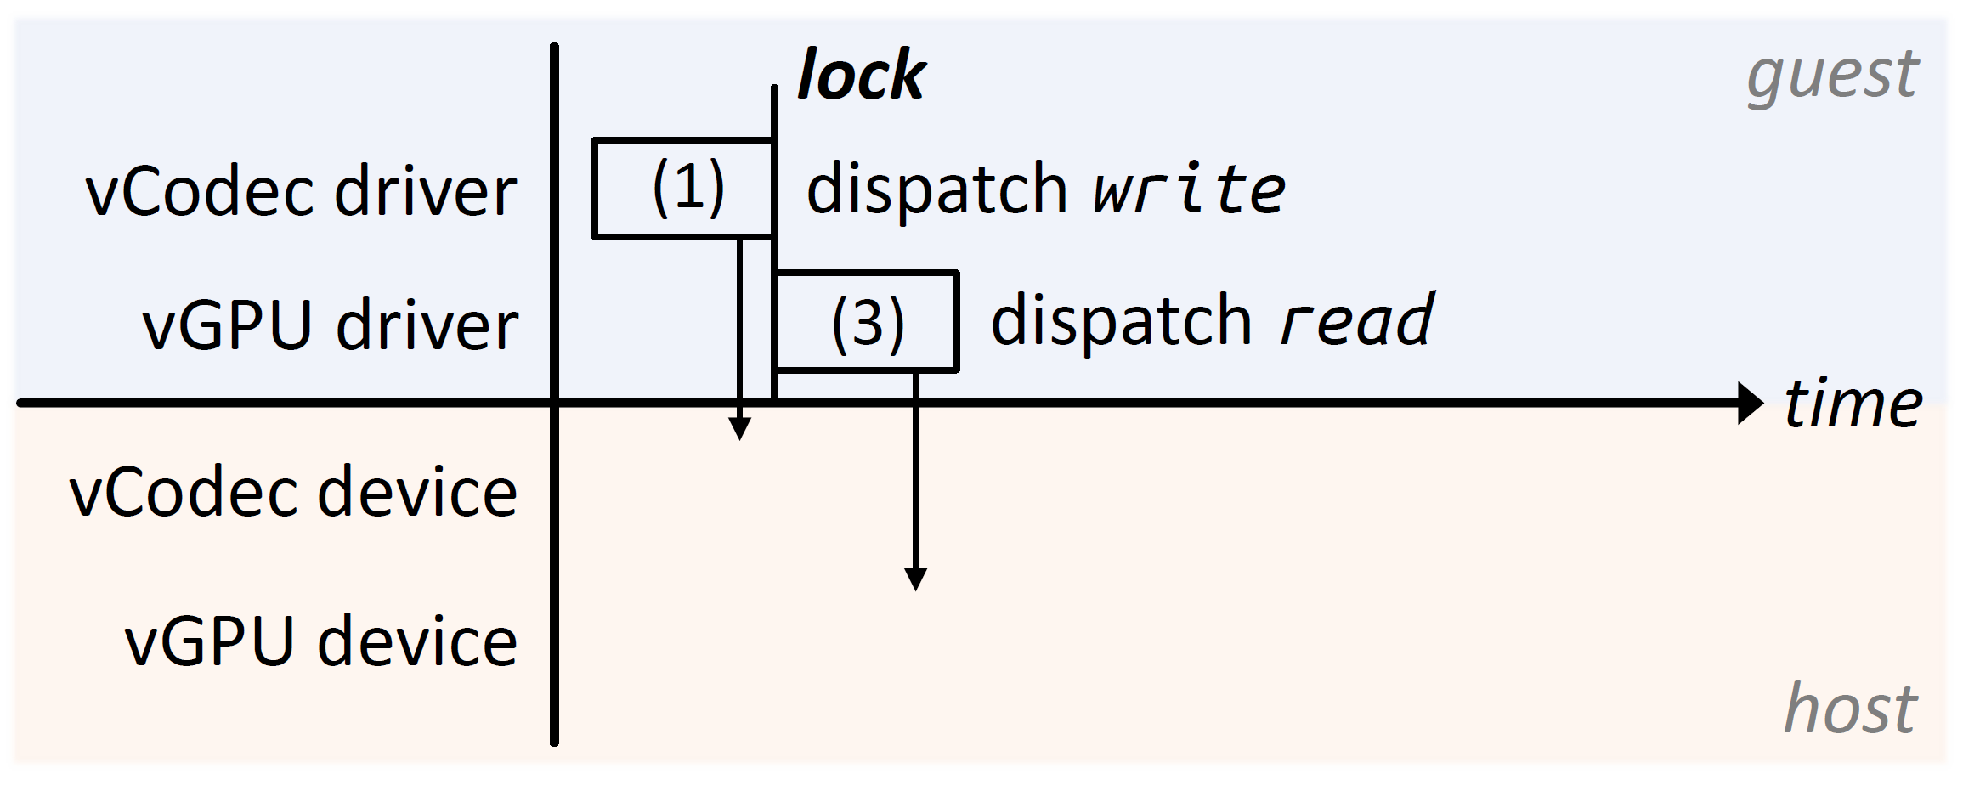
vSoC > Virtual Fence > the Problem
Background: virtual devices and the guest are scheduled independently
  emulator needs to sync cross-device accesses to shared resources
Take video rendering for example
  codec writes to an SVM region which is read by GPU afterwards
Notes:
The background problem of the mechanism is that virtual devices and the guest are scheduled independently. As shown in the figure, guest drivers dispatch asynchronous commands to virtual devices. The guest drivers can ensure that the write command is dispatched before the read (click), by using synchronization primitives like mutex locks

Slide 32
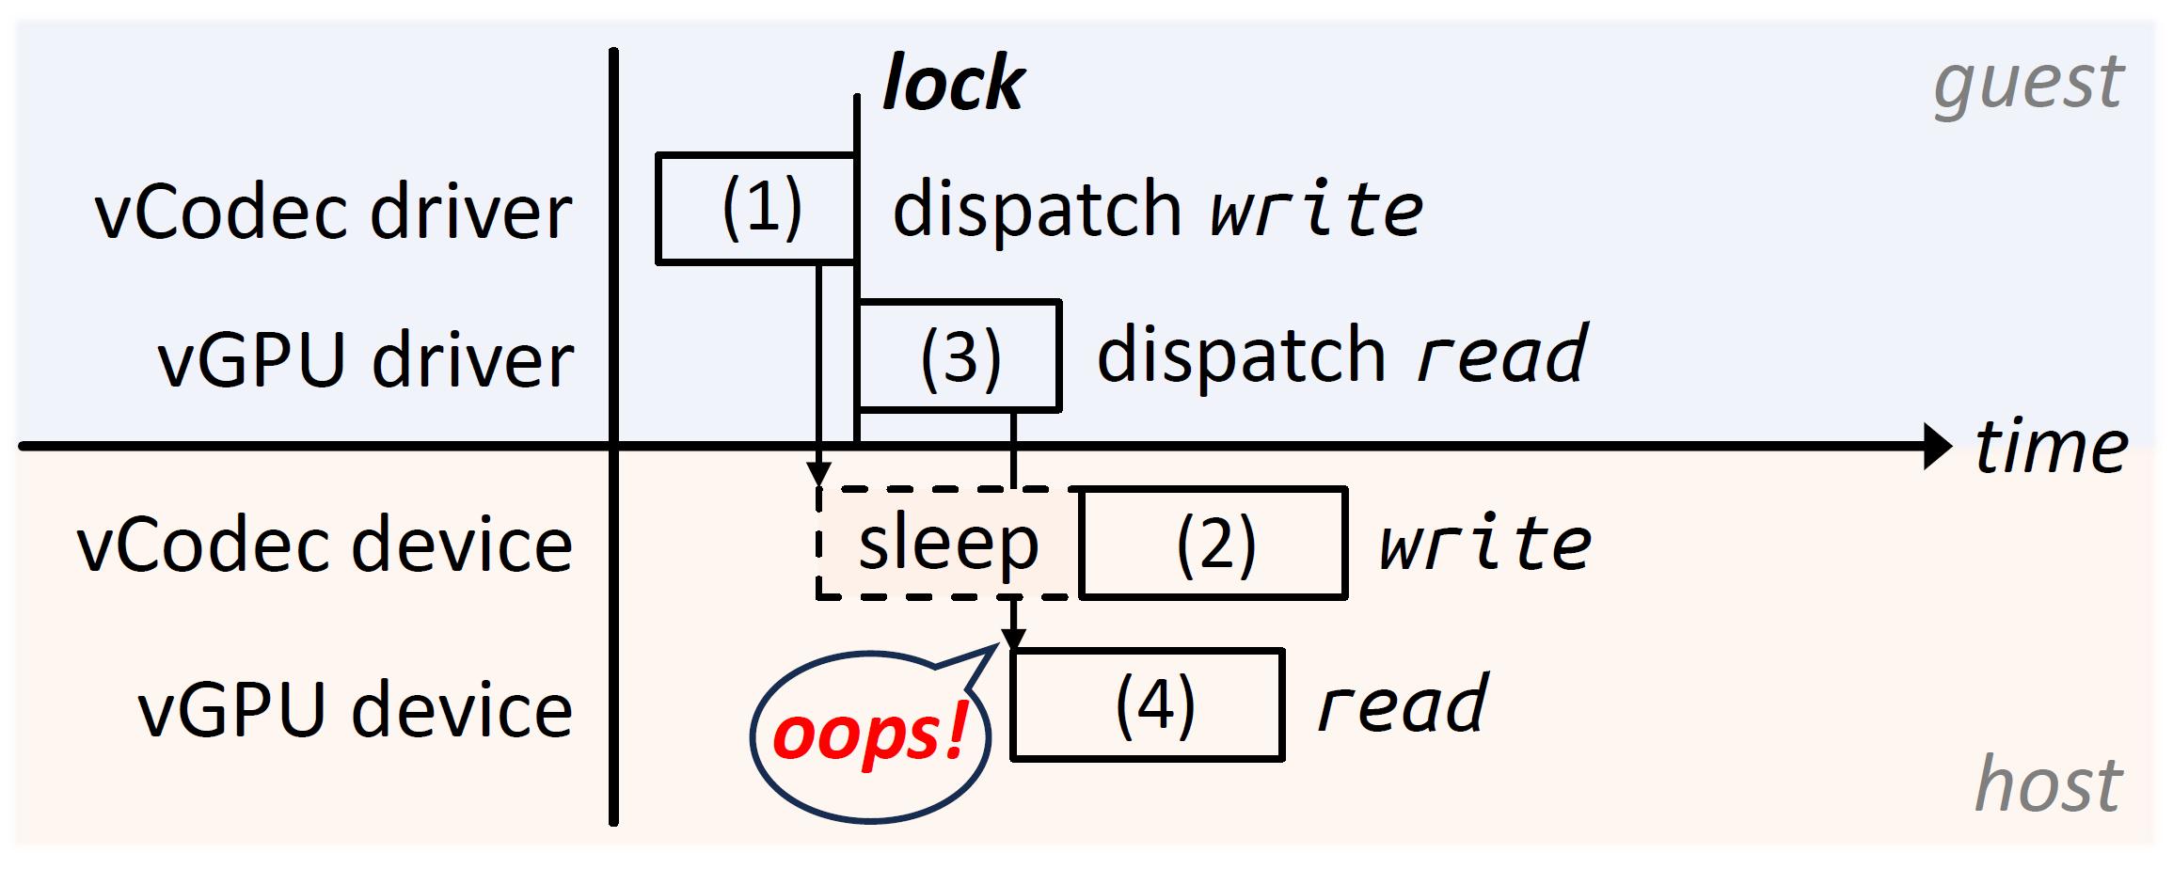
vSoC > Virtual Fence > the Problem
Background: virtual devices and the guest are scheduled independently
  emulator needs to sync cross-device accesses to shared resources
Take video rendering for example
  codec writes to an SVM region which is read by GPU afterwards
  supposedly (2) should be before (4), but that is not always the case
Notes:
The background problem of the mechanism is that virtual devices and the guest are scheduled independently. As shown in the figure, guest drivers dispatch asynchronous commands to virtual devices. The guest drivers can ensure that the write command is dispatched before the read (click), by using synchronization primitives like mutex locks
. But host virtual devices are independently scheduled, and if the emulator does nothing to order cross-device commands, out-of-order execution will happen.

Slide 33
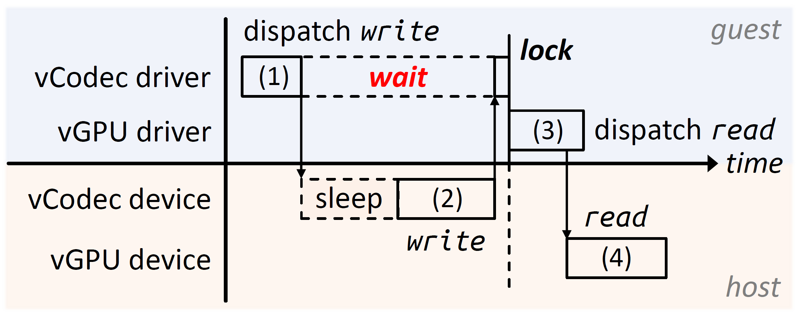
vSoC > Virtual Fence > Existing Solution
Atomic operation: driver waits until virtual device finishes
Problem: blocks the codec driver, delaying subsequent commands
…
vCodec driver command queue
Notes:
为了解决这个问题，主流模拟器普遍采取原子操作的经典方案。它的机制原理如图所示，就是让Codec编解码驱动发出写指令后，等待vCodec虚拟设备真正写完，然后再继续。虽然此时虚拟设备确实一定先写后读，但是问题就是codec驱动被阻塞，后续任务会因为无法及时被处理，降低吞吐量。(click) The essential challenge to efficient access ordering is that …

Slide 34
vSoC > Virtual Fence > Existing Solution
Atomic operation: driver waits until virtual device finishes
Problem: blocks the codec driver, delaying subsequent commands
Challenge: guest-host control synchronizations bring non-trivial overhead
…
vCodec driver command queue
Notes:
为了解决这个问题，主流模拟器普遍采取原子操作的经典方案。它的机制原理如图所示，就是让Codec编解码驱动发出写指令后，等待vCodec虚拟设备真正写完，然后再继续。虽然此时虚拟设备确实一定先写后读，但是问题就是codec驱动被阻塞，后续任务会因为无法及时被处理，降低吞吐量。(click) The essential challenge to efficient access ordering is that command orders are only known to the guest, but need to be enforced in the host, leading to frequent guest-host control synchronizations that bring non-trivial overhead.

Slide 35
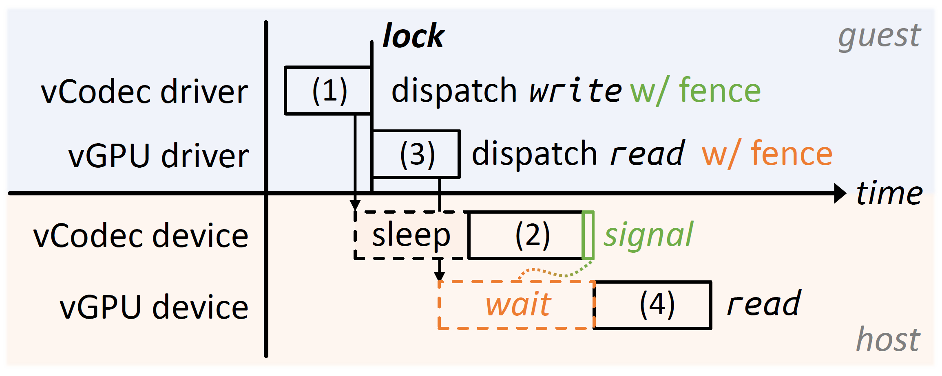
vSoC > Virtual Fence > the Mechanism
Virtual command fences push guest order semantics down to the host
  using two types of fences: signal fences “happens before” wait fences
  virtual fences are translated to device-specific synchronization primitives in the host
Notes:
Therefore, we propose virtual command fences. The core idea of the mechanism is to (click) push order semantics from the guest down to the host，这样宿主机就可以根据传下来的语义自行同步，无需客户机参与。具体而言，我们成对使用两种屏障指令，signal 屏障和 wait 屏障，来表示指令执行顺序。As shown in the bottom half of the figure, all the commands before the green signal fence (including the vCodec write) must happen before the orange wait fence, and therefore, before any subsequent commands including the vGPU read. And that’s how virtual fences work.

Slide 36











Evaluation Setup
Baselines: five mainstream mobile emulators
Workloads
  The 50 emerging apps + top-25 popular apps in Google Play
Trinity
Google Android Emulator
QEMU-KVM
LDPlayer
Bluestacks
Trinity
Notes:
We integrated the above designs, implemented vSoC, and compared it against five mainstream mobile emulators Due to time restraints, I will only introduce application benchmark results, 应用选择了表中的50个新兴应用以及Google Play的 Top-25 热门应用。

Slide 37
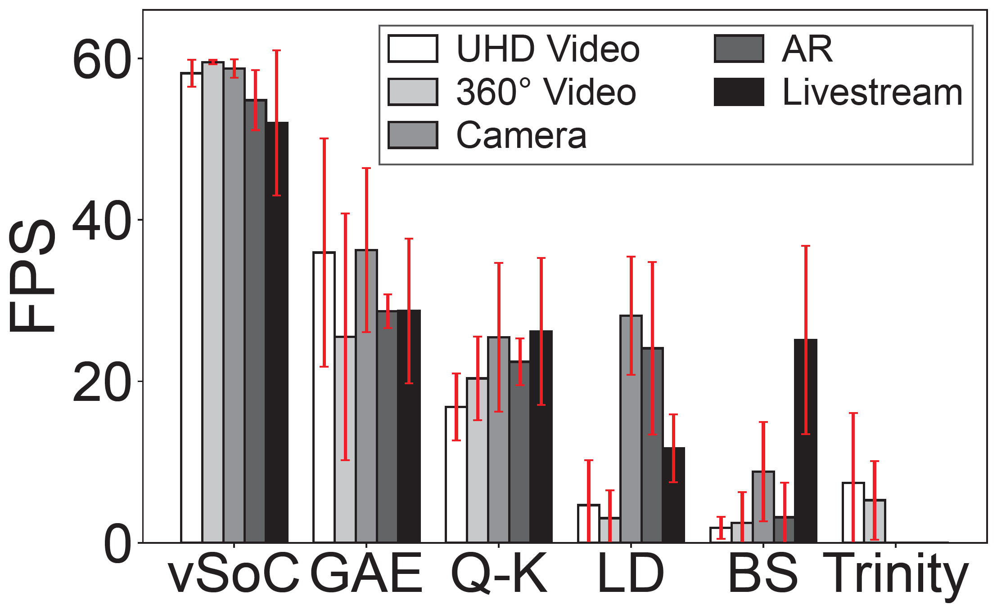
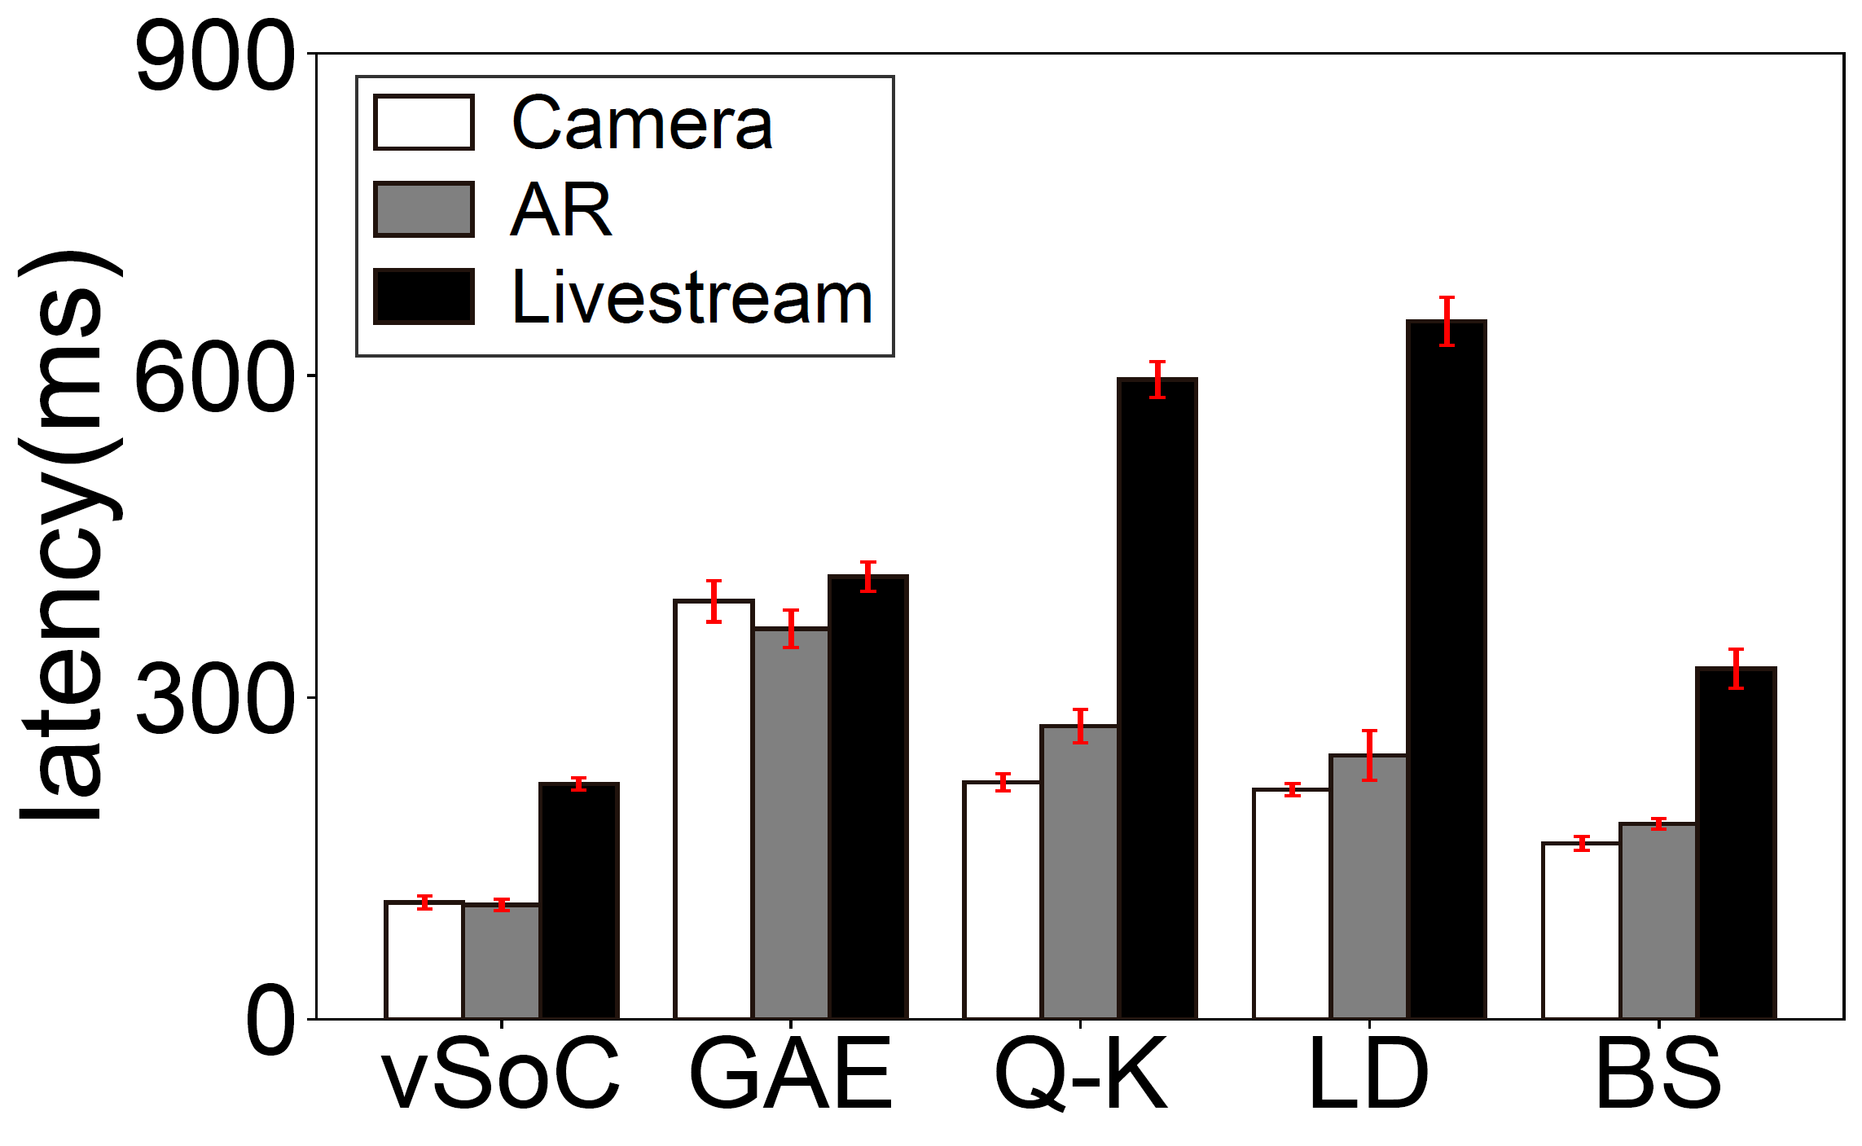
Evaluation Results
Emerging apps
  1.8× - 9.0× FPS
  35%-62% lower latency
Notes:
For emerging apps, vSoC runs at nearly full FPS on all the five app categories and can achieve 1.8-9 times FPS compared to other emulators. vSoC reduces latency by 35%-62% as well. The significant performance improvements are because 新兴应用频繁和多个设备交互，所以我们对于共享内存的提升效果显著。

Slide 38
Evaluation Results
Emerging apps
  1.8× - 9.0× FPS
  35%-62% lower latency
Top popular apps
  12%-49% FPS improvement
Notes:
就热门应用而言，虽然他们并不会那么频繁地使用各种设备，但是很多移动系统服务（比如安卓的UI库）也会用到共享内存，所以我们的设计也可以提升他们的FPS。

Slide 39
Conclusion
Emulator performance bottleneck: memory architecture discrepancy
Understanding of mobile shared memory: slack intervals
Key to an efficient virtual SoC: virtual SoC ≠ sum(virtual devices)!
1.8× - 9.0× performance improvements on emerging mobile apps
Adoption by HUAWEI DevEco Studio
Artifact available at: https://github.com/virtualsoc/vsoc
Special thanks to Tsinghua Deng Feng Fund
Notes:
That’s the end of my talk, thank you for listening!

